Slide 1
Learning R Workshop
A Ravenously Rambunctious
Rendezvous with R

Slide 2
What You Will Be Able to Do by the End of This Workshop
Read in data and move it, split it, cut it, etc.
Descriptive statistics (mean, SD, skewness, kurtosis, Cronbach’s alpha, etc.)
Inferential statistics (t-tests, chi-square, correlation, regression, ANOVA, basic multi-level models)
Graph data, produce pretty outputs
Read minds

Slide 3

Why R is so R-some!

Slide 4
Why Use R?
Free and open-source (unlike $P$$)
Packages for virtually anything you could think to do
Currently over 10,000 packages, and growing exponentially
Often location of most cutting-edge statistical tools
Notes:
Source: http://r4stats.com/2013/03/19/r-2012-growth-exceeds-sas-all-time-total/

Slide 5
Cool R Packages
Factor analysis (psych, nFactors)
SEM (lavaan, sem, OpenMx)
Multiple imputation (mice)
Bootstrapping (boot, MBESS)
Content analysis (tm, wordnet, ReadMe)
Bayesian analysis (BayesFactor, rjags, rstan)
Machine learning (caret, randomForest, nnet, e1071)
Web scraping (rvest, rjson, twitteR)
Notes:
Lots more packages are available -- over 5000 so far, and growing exponentially (http://r4stats.com/2013/03/19/r-2012-growth-exceeds-sas-all-time-total/). If you can think of it, there’s probably a package to do it. And if there isn’t, R is flexible enough as a programming language that you could probably make one yourself. (Provided you have the time, skill, and motivation, of course.)

Slide 6
Why Use R?
Growing popularity of use among academics
Notes:
By abstracting out common tasks into a function, or repeating tasks with loops, you can increase the efficiency of your workflow.

Slide 7
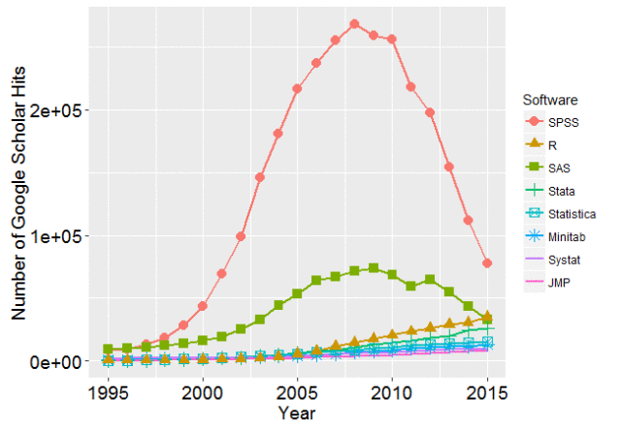
Growing Popularity in Scholarly Articles
200,000
100,000
0
Source: http://r4stats.com/articles/popularity/

Slide 8
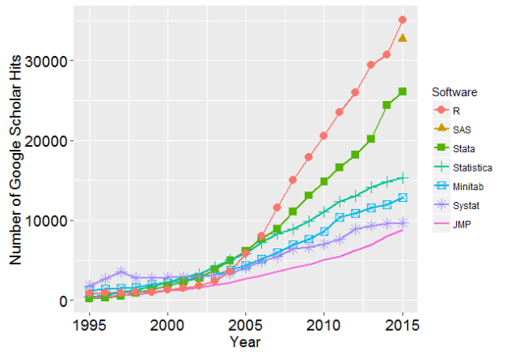
Growing Popularity in Scholarly Articles
Source: http://r4stats.com/articles/popularity/

Slide 9
Why Use R?
Growing popularity of use among academics
For online stats discussion, R has become the de facto standard for sharing code

Slide 10
Why Use R?
R is a full programming language, which offers lots of ways to increase efficiency of your workflow
E.g., functions and loops
Loops let you repeat a certain action multiple times
Functions let you abstract a commonly-used action for reuse elsewhere

Slide 11
Disadvantages of R
Can be challenging to learn initially, especially if first experience with programming
Output looks different from SPSS at times, sometimes makes different assumptions
Error messages can be difficult to understand

Slide 12


Statistics
+
Programming

Slide 13
Workshop Outline
Tuesday, May 9
Thursday, May 11
Why use R?
Introducing R
Saving and loading data
Descriptive statistics
Transformations
Inferential statistics
R’s basic data structures
Splitting and subsetting data
Visualizing your data
Advanced data wrangling
Troubleshooting problems
R Markdown and R Notebooks

Slide 14
Workshop Guidelines
If you get an error:
First, check if you’ve made a typo
Second, CHECK IF YOU’VE MADE A TYPO
Feel free to ask me so we can figure out the problem
Play around with the code!
It’s hard to break anything too badly in R; worst case scenario, just rerun the previous code
Ask lots of questions!

Slide 15

Introducing R
R

Slide 16


R vs. RStudio
R provides a very basic console for running R code
RStudio is a “development environment” for R that provides a nice user interface
When you open RStudio, it automatically starts up R in the background
Provides a place for editing R scripts, viewing plots, looking up documentation, and viewing your data

Slide 17

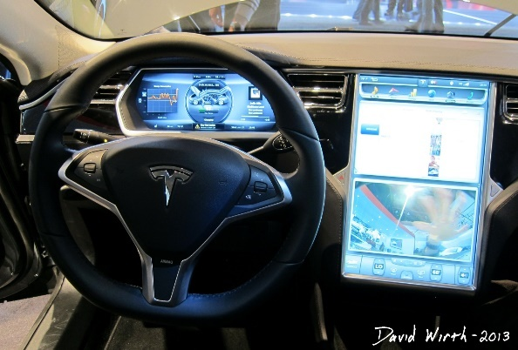
R vs. RStudio
R is the “engine” that runs everything, but RStudio provides all the bells and whistles for a more pleasant experience
Remember: R and RStudio are two different programs, and you need to update them separately

Slide 18
Math Operators
Operator | Description | Example
+ | Addition | > 3 + 2 [1] 5
- | Subtraction | > 7 - 2 [1] 5
* | Multiplication | > 3 * 5 [1] 15
/ | Division | > 8 / 2 [1] 4
^ or ** | Exponent | > 3^2 [1] 9
%% | Modulus (remainder) | > 5 %% 2 [1] 1

Slide 19
Comments
Comments in R are denoted with hash marks (#)
Anything to the right of a hash mark will be ignored by R
Use comments liberally!!
# this code standardizes the variable
data$column <- scale(data$column)
range(data$column) # find the min and max

Slide 20

Assignment Operator
<-

Slide 21
Functions
Functions are the commands you type to get R to perform actions
General form:
function.name()
Functions always:
Perform an action
Return some kind of output
Functions often have arguments
These provide the “settings” for the function

Slide 22
Function Arguments
General form:
function.name(first.arg = value1, second.arg = value2, third.arg = value3)
Each argument has a name
If you use the argument names, you can specify the arguments in any order
function.name(third.arg = 2, first.arg = 7, second.arg = 12)
If you don’t use the argument names, you must specify them in the proper order
function.name(7, 12, 2)
Many function arguments have default values, so you don’t have to specify the argument unless you don’t want the default

Slide 23
Function Arguments
Example: the t.test() function
t.test(x, y=NULL, alternative=c("two.sided", "less", "greater"), mu=0, paired=FALSE, var.equal=FALSE, conf.level=0.95, ...)
At minimum, it must take a data object
t.test(data)
Can have other arguments too
t.test(data, mu=5)
t.test(data, mu=5, alternative="greater")

Slide 24
Finding Info on Functions
Functions in R have documentation: mini-manuals for each function explaining what it does
In RStudio, they appear in the bottom-right panel
You can access help files in three equivalent ways:
Type the name into the search bar in the help tab
?function.name (note no parentheses after function name)
help(function.name)

Slide 25
Help Files
Help files are your best friends!!
Description: Offers a brief description of what the function does
Usage: Syntax for how to use function
Arguments: Explains meaning of each argument and its possible values
Details: More detailed usage notes
Value: Describes the type of output the function returns

Slide 26
Exercise
Go to the help file for “t.test” and find out how it (by default) handles homogeneity of variance

Slide 27

Packages

Slide 28
Packages
R packages are extra add-ons containing useful functions
R comes pre-packaged with some basic tools:
E.g., saving and loading data, basic stats functions (e.g., descriptives, correlation, regression, t-tests), basic plots
However, there are thousands of other packages to do virtually anything else you can think of
R packages have their homes on CRAN: https://cran.r-project.org

Slide 29
Using Packages
To use an R package:
You first need to install it on your machine
This only needs to be done once
install.packages("package.name")
The package name is case sensitive, and must be in quotation marks
To use it in a particular session, you need to load it
This needs to be done in each session you want to use it
library("package.name")

Slide 30
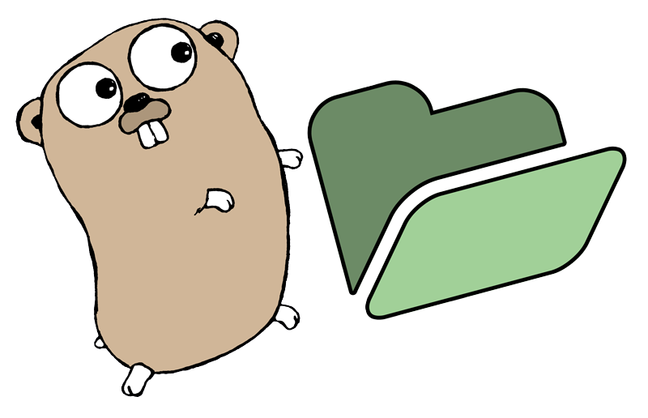
Working with the Working Directory

Slide 31


Working Directory
C:/Users/Jeff/Documents/
…
Two ways to specify file path:
Full path:
“C:/Users/Jeff/Documents/
Research/Project3/File3”
Research
Relative path:
“Project3/File3”
Project1
Project2
Project3
File1
File2
File3
File1
File1
File2
File3

Slide 32
Working Directory
Get current working directory with: getwd()
Set working directory with: setwd()
Usually best practice to do one of the following:
Always use absolute filepaths (i.e., “C:/…”)
Set the working directory at the top of each script file

Slide 33
Working Directory
Easy way to get file paths:
Windows
Press the SHIFT key and right-click on the file/directory
Select “Copy as path” and paste into R
Mac
Right-click on the file/directory
Press the OPTION key
Select “Copy [name] as Pathname” and paste into R

Slide 34
A Note about Windows
By default, Windows uses backslashes (\) in file paths
However, backslashes in R have a very specific meaning
When specifying file paths in R, two options:
Change all backslashes to forward slashes (/)
"C:/Users/Jeff/Documents/Research/file.Rdata"
Double all backslashes
"C:\\Users\\Jeff\\Documents\\Research\\file.Rdata"

Slide 35
A Typical R Session
Open RStudio, open a new R script (.R) file
Load the R packages that you want to use
Set your working directory (if needed)
Read in your data from a file
Be a nerd (i.e., do all your statistics)
Save your code and (maybe) some output files

Slide 36
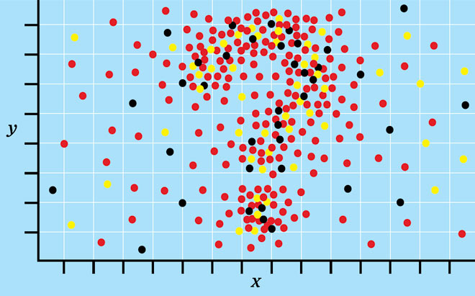
Doing Stats with R!

Slide 37
Our Example Data
Maximizing: Decision-making style marked by tendency to search through options to find the “best” option
Has been associated with greater regret with decisions, greater reconsideration of previously dismissed options (Hughes & Scholer, 2017)
Research question: Will high (vs. low) maximizers experience more regret on a decision when encouraged to ruminate over options, compared to simply deliberating on them?
(This is simulated data)

Slide 38
Our Example Data
Design:
Measured participants’ maximizing score
Prompted participants to think of an important upcoming decision in their lives, asked to think through options (either to make a change, or to leave things the way they are)
Prompts either encouraged them to deliberate about options, to ruminate about possibilities they may have missed, or a general no-strategy control group

Slide 39
Our Example Data
Design:
After engaging in the decision task, we measured the choice they would make (change or no change), level of regret they thought they might feel about decision
Also asked them before the choice task how close they were to making a decision, asked them again after

Slide 40
Go to code

Slide 41
Exercise
Find effect of maximizing on participants’ closeness to the decision (after decision task), and compare models with and without using closeness_before as a covariate

Slide 42
Go to code

Slide 43
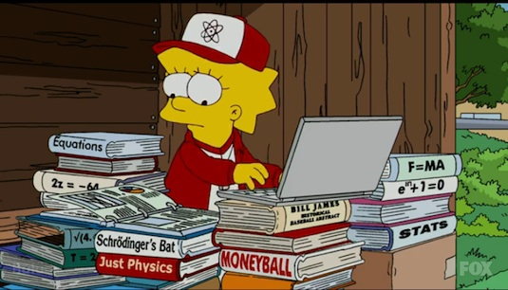
Advanced Statistics

Slide 44
Factor Analysis
‘psych’ package
Principal components analysis, factor analysis, item cluster analysis, etc.
Rotations: varimax, quartimax, promax, oblimin, simplimax, or cluster
KMO test
Plots and diagrams as well
Determining # of factors/components: parallel analysis, VSS, BIC
‘nFactors’ package
Determining # of factors/components: parallel analysis, acceleration factor, optimal coordinates, Bartlett χ², Bentler-Yuan χ²

Slide 45
Multilevel Models
a.k.a hierarchical linear models, mixed models, random effects models…
First need to change data from ‘wide’ to ‘long’ format; several methods commonly used:
reshape( ) from base R (already installed)
melt( ) and cast( ) from ‘reshape2’ package
gather( ) and spread( ) from ‘tidyr’ package

Slide 46
Multilevel Models
a.k.a hierarchical linear models, mixed models, random effects models…
Once in long format, two common packages used:
‘nlme’ | ‘lme4’
Older, can be slower | Newer, designed to be faster
Only handles normal DVs | Can handle GLMM
More flexibility in covariance structure (e.g., autoregressive) | Only select options for covariance structure (diagonal, unstructured, partially diagonal)
Provides p-values | No p-values* (can use ‘lmerTest’ package to supplement p-values)
* Package author’s reasoning: https://stat.ethz.ch/pipermail/r-help/2006-May/094765.html

Slide 47
Mediation Analyses
‘mediation’ package is a great package that supports numerous model types (e.g., linear, general linear, Bayesian general linear, multilevel)
Supports bootstrapping, moderated mediation, covariates
Sort of handles multiple mediators (but would recommend SEM instead)

Slide 48
Structural Equation Modeling
Lots of options, but two popular ones are ‘lavaan’ and ‘OpenMx’
Both support multiple groups, estimation of means, FIML for missing data, categorical variables, and bootstrapping
‘lavaan’ has much easier syntax
‘OpenMx’ has modular structure useful for combining models
‘OpenMx’ also supports mixed effects

Slide 49
Structural Equation Modelling
If you prefer a graphical interface like Amos:
Java applet called Onyx that provides OpenMx syntax for running in R (http://onyx.brandmaier.de/)
Not as feature-rich as Amos, but it’s an option

Slide 50
Other Interesting Packages
‘metafor’ for meta-analysis
‘WRS2’ for robust ANOVA (bootstrapped)
Cluster analysis: kmeans( ) and hclust( ) already installed; ‘mclust’ for model-based clustering; ‘cluster’ for several methods and plotting functions

Slide 52
Note about Workshop Materials
Some of the information in this workshop was adapted from the Introduction to R workshop by Elizabeth Page-Gould, available at: http://www.page-gould.com/r/uoft/

Slide 53



Note about Distribution of Workshop Materials
The slides and syntax for this workshop are the original materials of Jeffrey Hughes, distributed with a Creative Commons 4.0 International License
This means you may:
Freely share, distribute, and “remix” the slides and syntax
But only under the following conditions:
With attribution: You provide attribution to Jeffrey Hughes with a link to the original workshop materials: http://www.jeffhughes.ca/rworkshop
Share alike: If you alter or remix this work in any way, you must also share your final product with a license that has similar conditions to this one (e.g., to be distributed freely)

